Slide 1

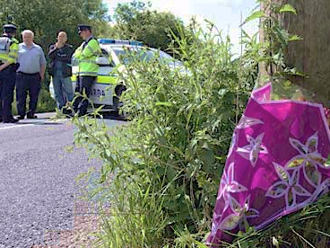
US ACCIDENT FATALITY DATA ANALYSIS
Aarti Kumthekar, Cathy Jing Qiu, Dennis Lyubyvy, Kedar Patil, Hafiz Ahsan
Columbia University | April 23rd, 2015

Slide 2
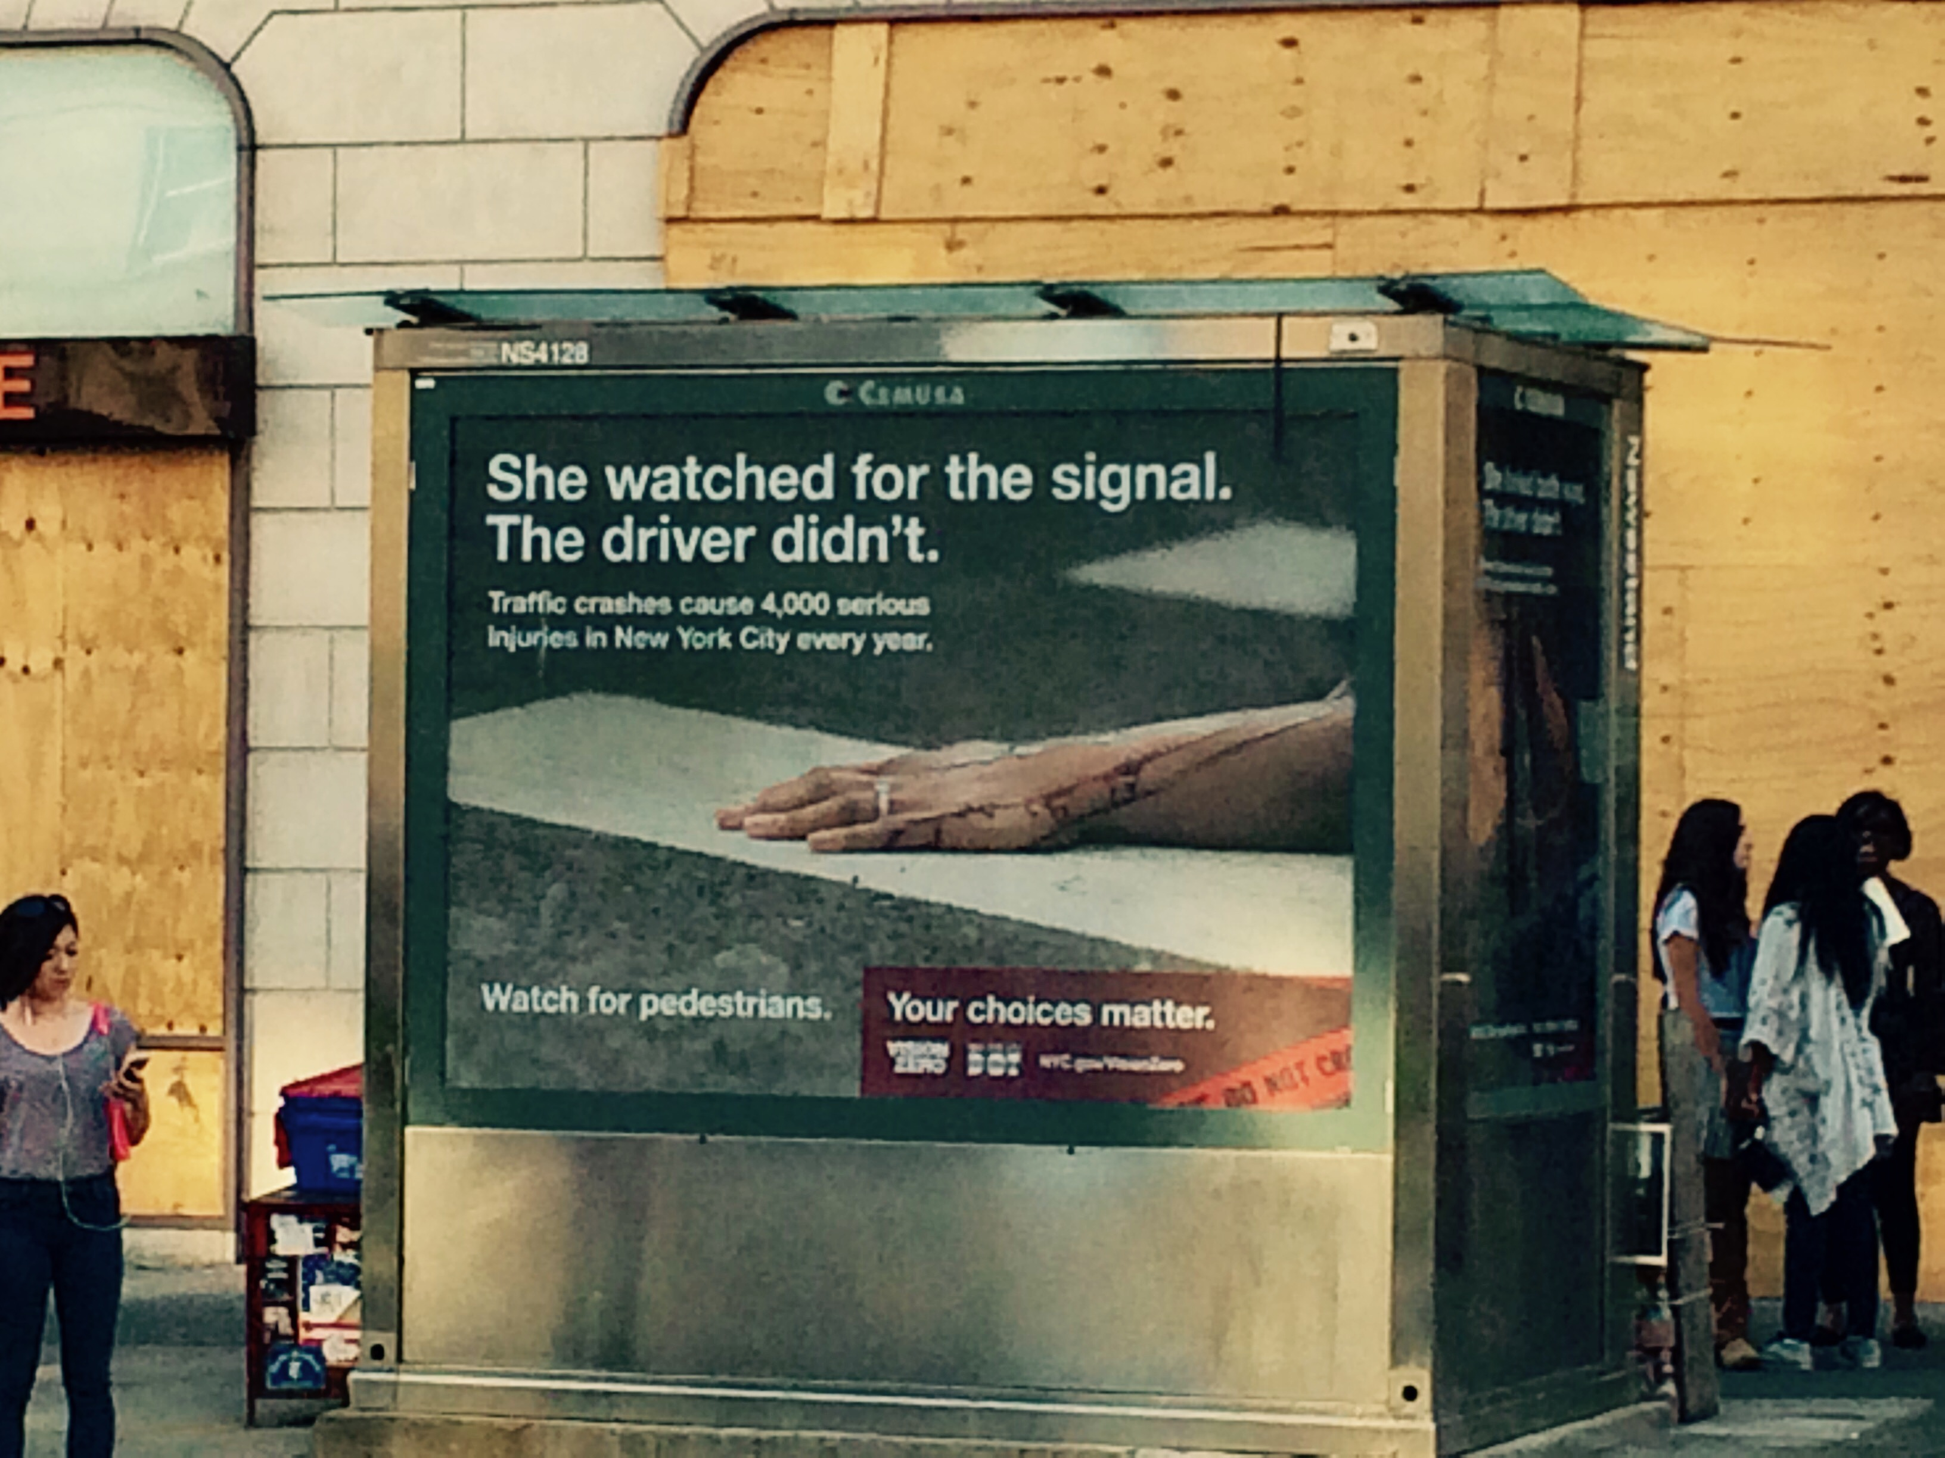
Our Motivation

Slide 3
“Together, we can save lives.”
-- Bill de Blasio, Mayor of New York City

Slide 4
Data Acquisition
What We Want:
National level accident data
Accident specific details
Behavioral details
Facts about surrounding area of crashes, road condition, road signs, etc.
NHTSA - National Highway Traffic Safety Administration
(Under US –DOT)
ftp://ftp.nhtsa.dot.gov/
Additional Data:
TREND, Annual vehicle miles, US state urban percent

Slide 5
Fatality Analysis Data Landscape
General Services Administration’s (GSA) publication of worldwide Geographic Location Codes (GLC).
USA
Supporting Data:
1) Fatality Trend – 1833-2012
2) Annual Vehicle Miles
3) Urban Percent – IOWA state
key to description manual feed
State, City, County GLC Keys
State, city, County Description
Case Number
Case Number
Case Number
Vehicle Number
Accident
Vehicle
Person
# of vehicles involved
# of Persons Involves
Motorist - Driver or Passenger, Pedestrians or cyclist
Location – Interstate, US highway
Long/Lat, jusction
Crash event, impact
Weather and Ligh condition
Fatalities
Drunk driver
Vehicle Number
# of occupants in the vehicle.
Vehicle Type – Passenger Car, Bus, Truck, Special vehicles – cab, emergency
Make/Model/Body type of the vehicle.
VIN – Vehicle identification number.
Fatalities
Drunk Driver
Person Type – Driver, Passengers etc.
Person age, Sex, zip code
Safety precautions followed
Safety measures mis-used.
Drinking/Driving
Alcohol Test results
Emergency arrived time
Transport to Hospital
Time taken to get emergency help.
Fatalities
Drunk Driver
# of vehicles involved
# of Persons Involves
Motorist - Driver or Passenger, Pedestrians or cyclist
Location – Interstate, US highway
Long/Lat, jusction
Crash event, impact
Weather and Ligh condition
Fatalities
Drunk driver
Time of the accident (Date – YYYY, Month, Date, Day of the week , Hour, Minute)

Slide 6
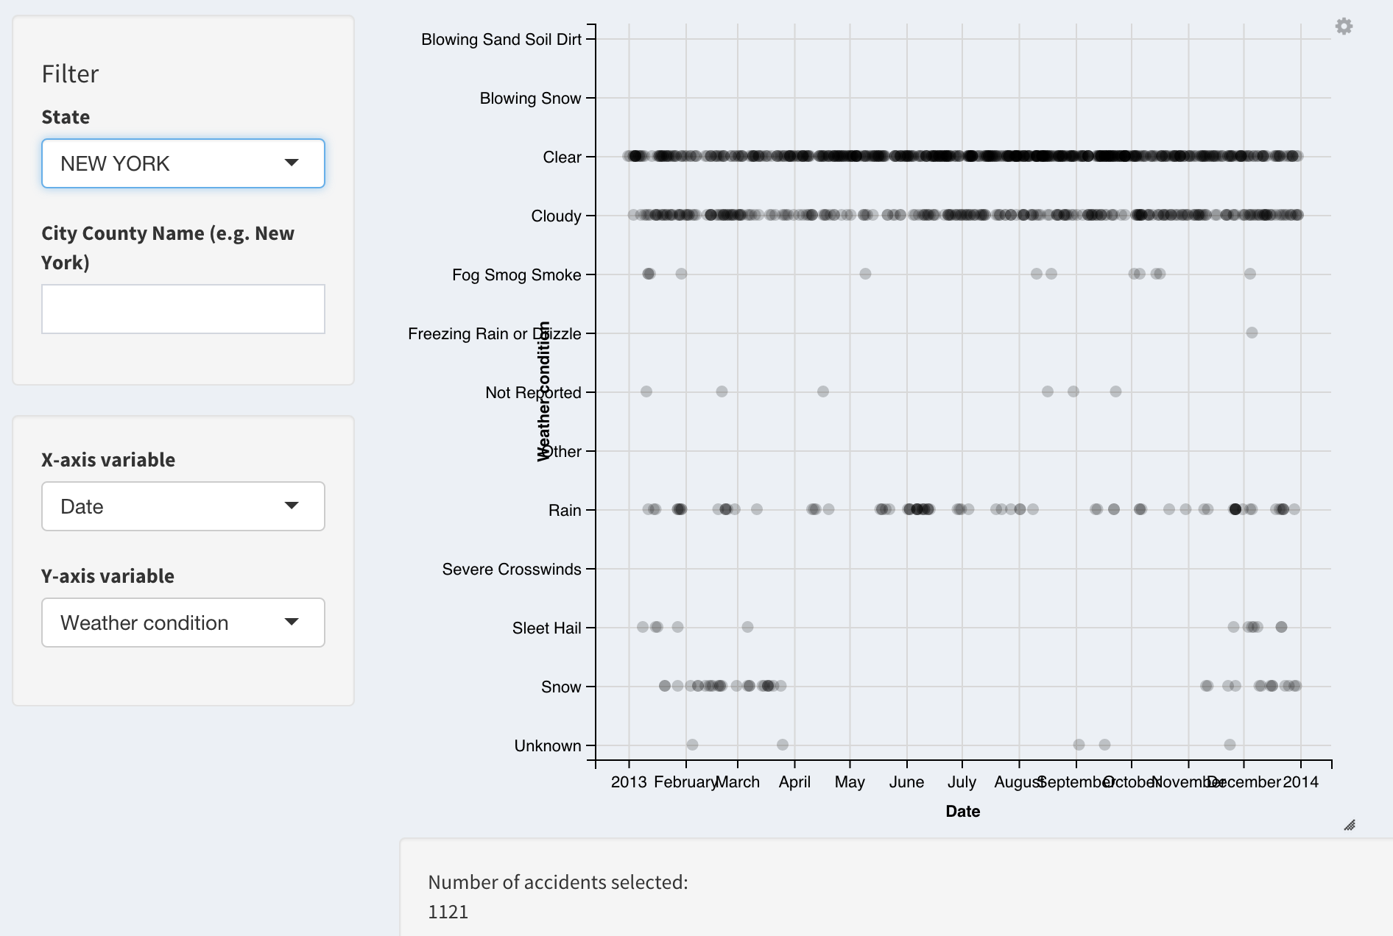
“Deleted Scenes ”

Slide 7
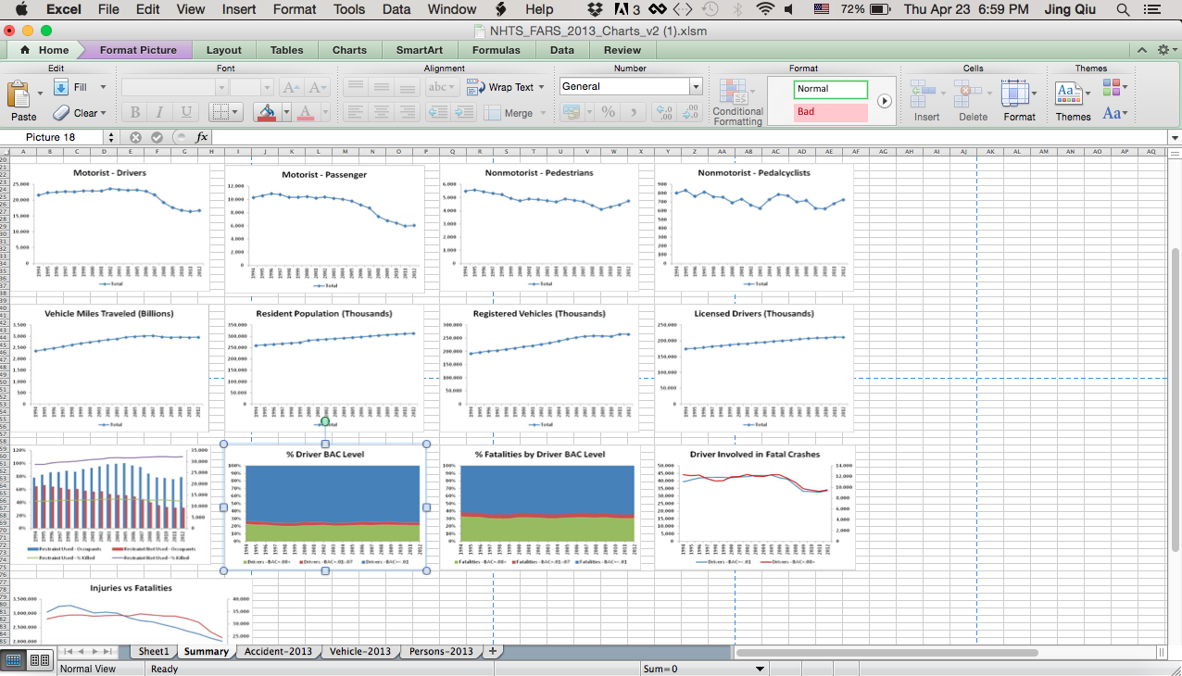
Data Exploration
Raw feeds ingested into excel and pivot tables used to quickly weed through data

Slide 8
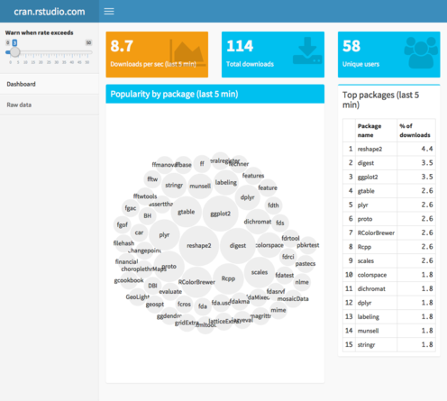
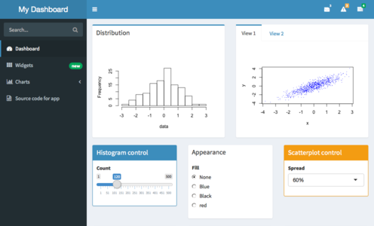
Platform Exploration
Shiny Dashboard

Slide 9
Our Journey
Main Idea:
US National Accident Fatality Analysis
Data Collection:
NHTSA & additional data
Data Exploration:
Excel & Tableau
Presentation Platform:
Shiny Dashboard

Slide 10
Introducing Shiny App

